Slide 1
Developing with Azure Functions

Slide 2
Agenda
Why Azure Functions?
Creating Azure Functions

Slide 3
The evolution of application platforms
On-Premises
IaaS
PaaS
Serverless

Slide 4
What is Serverless?
Abstraction of servers
Event-driven/ instant scale
Micro-billing

Slide 5
Benefits of Serverless
Manage apps, not servers
Reduced DevOps
Faster time to market

Slide 6








Serverless application platform components
Development
Platform
IDE support
Functions
Logic apps
Event Grid
Integrated DevOps
Developer productivity
Visual designer
Manage all events in one place
Triggers and Bindings
100+ connectors
Near real-time delivery
Local development
Flexible deployment options
Functions orchestration
Broad coverage
Monitoring
Database
Storage
Security & Access Control
IoT
Analytics
Intelligence
Visual Debug History

Slide 7
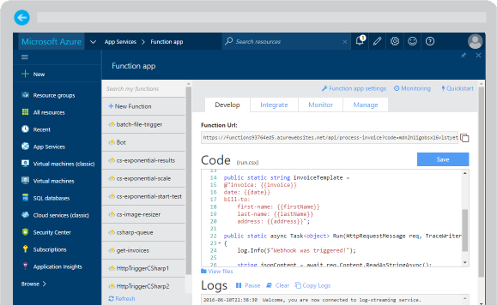
Azure Functions
Create a “serverless” event-driven experience that extends the existing Azure App Service platform by building “nanoservices” that can scale based on demand
Notes:
Azure Functions are part of the Azure Web + Mobile suite of App Services and are designed to enable the creation of small pieces of meaningful, reusable methods, easily shared across services. These serverless, event-driven methods are often referred to as “nanoservices” due to their small size. Although an Azure Function can contain quite a bit of code, they are typically designed to serve a single purpose, and respond to events in connected services.

Slide 8
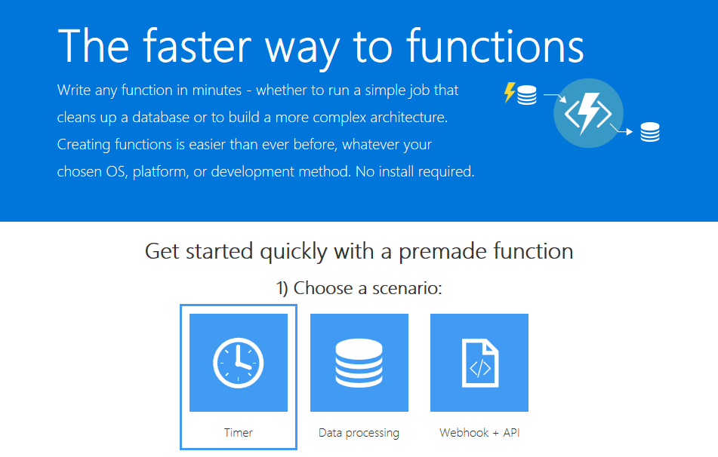
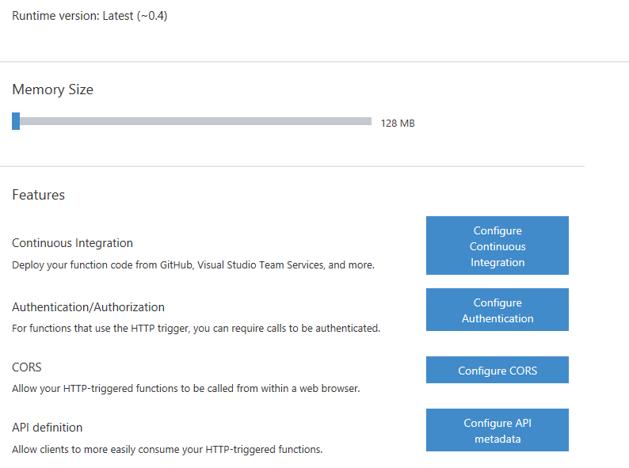
Supported Languages and Tools
JavaScript
C#
Python
PHP
Bash
Batch
PowerShell
Notes:
Azure Functions can be created in most common development and scripting languages, and can be “triggered” by events in other Azure App Services, such as Web, Mobile, Logic, and API apps. Azure Functions can also be exposed via HTTP URL schemes for easy integration into legacy systems.

Slide 9

Common Scenarios
Timer-based processing
Azure service event processing
SaaS event processing
Serverless web application architectures
Serverless mobile backends
Real-time stream processing
Real-time bot messaging
Your App or Service
Office 365
Office Graph
Azure Storage
Legacy Systems
Web Services
Other Functions
Notes:
Azure Functions are “event-driven” meaning they run based on associated and configure events, or “triggers”. For example an Azure Function could be triggered by a simple timer, such as running a process once every 24-hours, or triggered by an event in a document management system, such as when a new document is uploaded to a SharePoint library. Azure Functions can also respond to Azure-specific events, such as an image added to a Storage Blob or a notification arriving in a Message Queue.

Slide 10
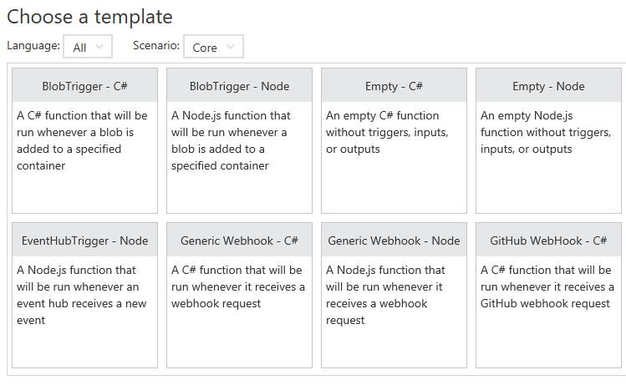
Function App Templates
Function App templates are categorized into general areas of Timer, Data Processing, and Webhook & API
BlobTrigger
EventHubTrigger
Generic webhook
GitHub webhook
HTTPTrigger
QueueTrigger
ServiceBusQueueTrigger
ServiceBusTopicTrigger
TimerTrigger
Blank & Experimental
Notes:
Although Azure Functions can be created from scratch”, the Azure Portal exposes a large number of ever-growing templates to help get developers started. These templates are typically designed with specific triggers in mind, such as a Blob Storage event, or a GitHub webhook event. Templates can easily form the basis for robust function creation, and are really designed just to get a developer started.

Slide 11
Timer Function Apps
Run at explicitly specified intervals
Example interval: every day at 2:00 am
Intervals defined using CRON expressions "0 */5 * * * *" - (every 5 minutes)
What do you do with a timer app?
Send information to other systems
Write to logs
Perform redundant cleanup and data management
Check state of services
Timer-based processing
Every 15 minutes
Find and clean invalid data
Clean table
Notes:
Timer Functions are exactly what they sound like: Functions triggered by a specific time event. Timer Functions are perfect for clean up and maintenance processes and can easily be combined with other functions for more robust scenarios. Timer Functions us CRON expressions to configure schedules. It’s a good idea to get familiar with CRON syntax, but in the meantime there are a number of tools online to help you build CRON expressions.

Slide 12
Data Processing Function Apps
Data processing functions triggered by data event
an item being added to a queue
A file being uploaded to a container
Data processing functions have in and out parameters
Great for responding to CRUD events
Great for performing CRUD events
Great for moving content
Access data across services
Real-time stream processing
Millions of devices feed into Stream Analytics
Transform to structured data
Store data in SQL DB
Notes:
Data Processing Functions are triggered by activity in a datastore, such as a table, queue, or container. Data Processing Functions also typically have both “in” and “out” parameters, meaning they can accept an object as a parameter, and then process information and then return another object from within the function. This is not the same as a “return” value, as most Azure Functions either return void, or an HTTP response such as “created”, “accepted”, or “OK”.

Slide 13
Webhook & API Function Apps
Functions triggered by events supported in other services
GitHub events (e.g. repository created, wiki page updated, etc.)
SharePoint events (e.g. list item added, document deleted, etc.)
Office 365 events (e.g. mail message received)
Takes in a request and sends back a response
Often mimic Web API and legacy web services flows
Typically need CORS settings managed
Best for exposing functionality to other apps and services
Great for building Logic Apps
Notes:
Webhook and API Functions are designed to easily integrate with 3rd party systems, like GitHub, Office 365, and especially Microsoft PowerApps. Since Webhook and API Functions are often exposed to external or legacy systems, they typically need CORS settings managed in order to “allow” external resources to “see” and execute the function. Most Azure Logic Apps leverage Webhook and API Functions directly.

Slide 14
Anatomy of a Function
A function can be defined by…
A “Run” file containing function code
A “Function” file containing all service and trigger bindings and parameters
A “Project” file containing project assembly and NuGet package references
App Service settings, such as connection strings and API keys
code
Executable code
Function configuration
.NET Core and Project references
Notes:
An Azure Function is really a group of a few files that work in harmony. All actual function logic resides in a “Run” file written in a language of choice. A “Project” file is similar to a project file in other technologies such as .NET Core or Universal Windows Platform and contains “secondary” assembly references such as NuGet packages. Finally a “Function” file contains information about triggers and parameters, such as locations of Storage Queue connection strings and whether the parameter is design as an “in”, “out” or “bi-directional”. Optionally, additional configuration is also found in the Function App Settings such as an API Key or database connection string.

Slide 15
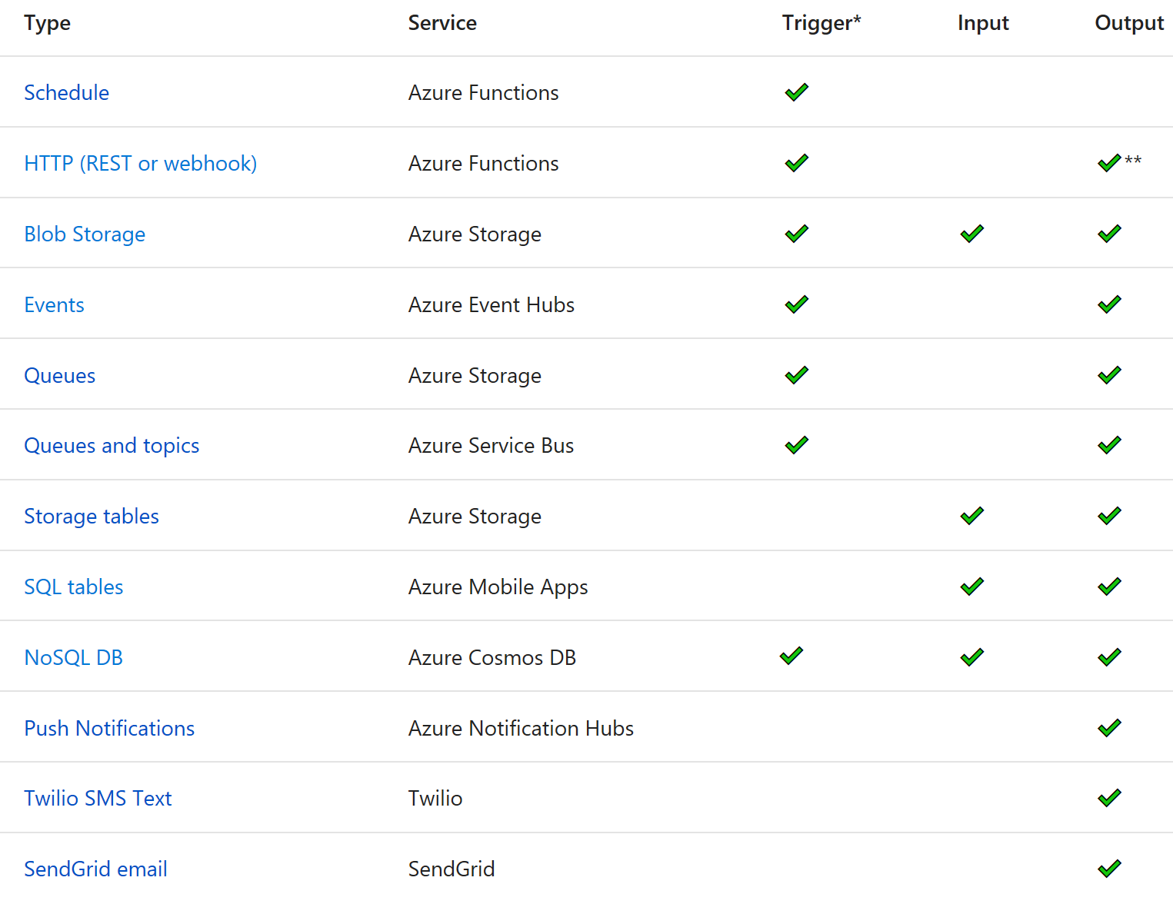
Azure Function Types

